Slide 1
EOI
Understanding how it works and how it is managed

Slide 2
Evidence of Insurability (EOI)
  Evidence of Insurability (EOI) - an application process in which you provide information on the condition of your health or your dependent's health in order to be considered for certain types of insurance coverage.
  Guaranteed Issue (GI) – This is the amount that is guaranteed to be offered to a member, regardless of health. The member cannot be declined or turned down for this amount.
  EOI is required when the employee does not have/or has exceeded the guarantee issue amount. The employee then needs to submit documentation to the carrier for the underwriter to determine if they are approved for the additional requested amount
  The employee must fill out the EOI form and submit it to the carrier to be approved for the additional requested amount. Failure to submit this form would result in their request being canceled, only giving the employee the guarantee issued amount, or potentially cancelling the entire enrollment request
  *Allstate Cancer does require EOI, but this has currently been waived for NCFlex*

Slide 3
NCFlex Group Term Life - Evidence of Insurability (EOI)
  EOI consists of health questions that may include your current health status, medical history, and family medical history.
  New Employee – may elect $20,000 up to $200,000 on themselves and $20,000 up to $50,000 on their spouse without EOI.
  *Dependent coverage cannot exceed subscriber Life enrollment*
  Existing Employee during OE
  -if employee and their spouse are not currently enrolled in group term life
  coverage then they may purchase $20,000 on a guaranteed issue basis.
  Amounts over $20,000 require EOI.
  -if employee and their spouse are currently enrolled in group term life
  coverage then you may add up to $20,000 additional up to the guaranteed
  issue amount of $200,000 for employees and $50,000 for spouse.
  Existing Employee outside of OE – if the member experiences a qualifying life event that allows them to add or increase life insurance, employee will receive a guarantee issue amount of $200,000 and spouse has a guarantee issue of $50,000. Anything over the GI will require EOI.

Slide 4
Effective Dates of Coverage
  New Employee – the first day of the month following the date of hire
  Existing Employee during OE – 01/01
  Existing Employee outside of OE – the first day of the month following the life event
  Pending EOI – the first of the month following the date the EOI is approved (ie if EOI is approved 03/05 then the updated coverage amount is effective 04/01)

Slide 5
EOI Life Cycle
Member logs in and elects a group term life amount that requires EOI. See slide 6 for visuals
Election is sent over to Lifehelp & VOYA on the weekly Monday files
EOI forms are sent to the member’s address to be filled out and returned.
VOYA reviews the returned forms and decides to approve or decline the request. (Turn around time for a decision is approximately 120 days.)
Benefitfocus is sent a weekly report from VOYA and updates the approvals and declines in eEnroll.
See slide 7 for additional details

Slide 6
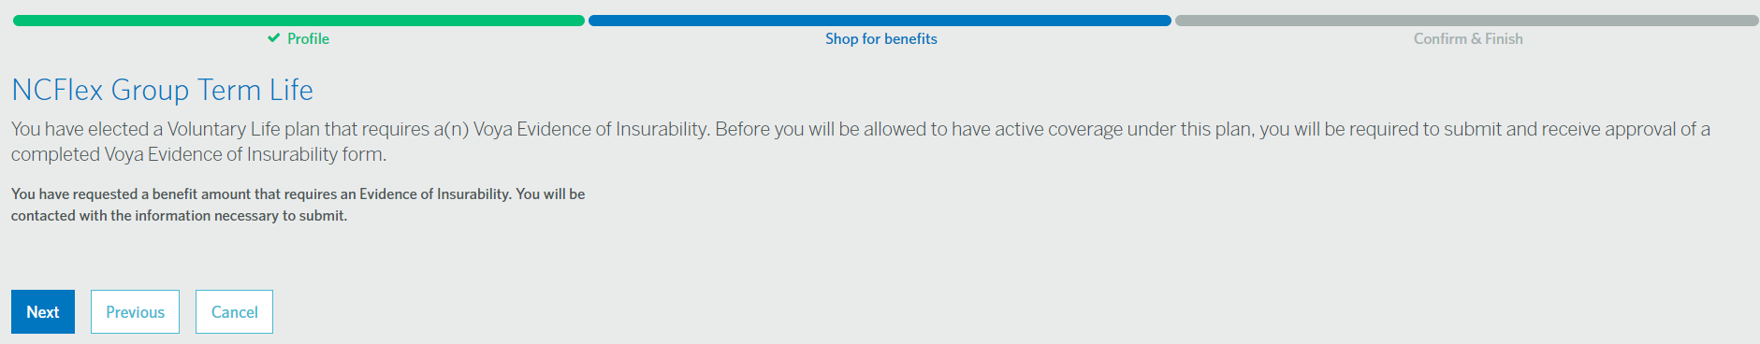
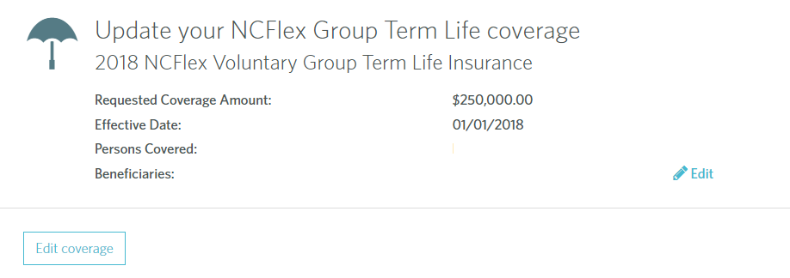
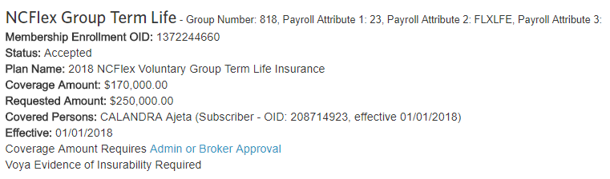
Member logs in and elects a group term life amount that requires EOI.
Members are notified in eEnroll if EOI will be required, after making the coverage level change in eEnroll
Employee View
HR View

Slide 7
EOI Life Cycle
Benefitfocus is sent a weekly report from VOYA and updates the approvals and declines in eEnroll.
Approved
Denied
Cancelled
Benefitfocus Approves the amount, based on VOYA’s decision, the effective date following the approval (member reflect covered for $30,000, requested a total amount of $100,000. Up until this point, the member should have been payroll deducted for $30,000. For example, once VOYA approves the member on 04/20, the member will reflect $30,000 01/01 – 04/30, and $100,000 effective 05/01/18.
Benefitfocus approves the amount based on VOYA’s decision. If the member had a Gaurantee Issued amount, and that additional requested amount was not approved, eEnroll will only reflect an approval for the Gaurantee Issued amount, reflecting the original effective date.
If a EOI request is canceled, this is due to the member not sending in the required EOI paperwork. This request will reflect a cancelled status in LifeHelp. Benefitfocus will then only approve the member for the GI amount with the original effective date (this approval will be keyed approximately 60 days after the member has been placed in a canceled status. If the entire EOI amount was pending (due to using a life event), the entire enrollment will be cancelled.
*If a member is placed in a cancelled status, VOYA could potentially still receive their EOI paperwork and update the status (approve/deny) the request up to 60 days after the cancellation date*

Slide 8
Best Practices
  Pulling a Pending EOI Report within eEnroll, to identify if there is an employee who has pending EOI that has an effective date more than 4 months back (i.e. Pull the report in May, and look for members who have an effective date of 01/01)
    This would be recommended to be pulled monthly, or quarterly based on the Employing Unit’s work load
    Once an employee is identified to still have pending EOI past the time that would be expected, a One Place 365 case would need to be filed to request this member to be looked in to, and potentially put in the correct state
    If this is not managed regularly, by identifying EOI that is pending longer than the expected time frame, this could have impacts with the employee not being deducted the appropriate amount.
  Benefit Detail Report
    Data & Reporting > Standard Reports > Benefit > Benefit Detail
    Filter by benefit type – Group Term Life (member, spouse, and child) > Create report
  Pending EOI Report
    Data & Reporting > Standard Reports > Benefit > Pending EOI
    Filter by participation period > Create report

Slide 9
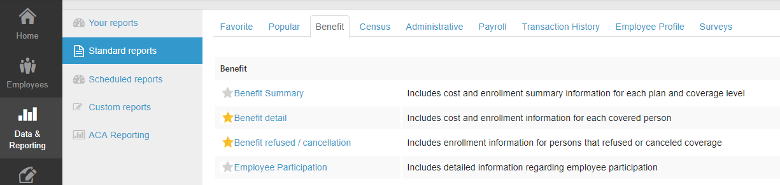
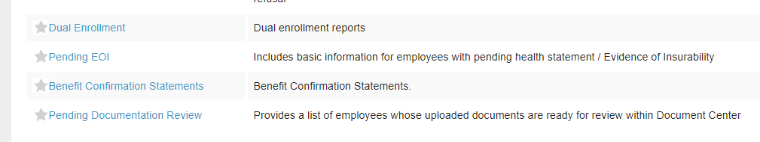
Benefit Detail Report
Pending EOI Report

Slide 10
  Questions??

