Slide 1

Let’s lunch and learn!
June 2026
If you participate in the State Health Plan, you can find a nutritionist near you by logging into your Aetna account.
Dietician visits are covered at 100 percent when an in-network provider is used. Visit www.shpnc.gov to learn more.
For future Worksite Wellness Lunch and Learn events or recordings of previous events, visit oshr.nc.gov/wellness-webinars.
Hosted by:

Slide 2
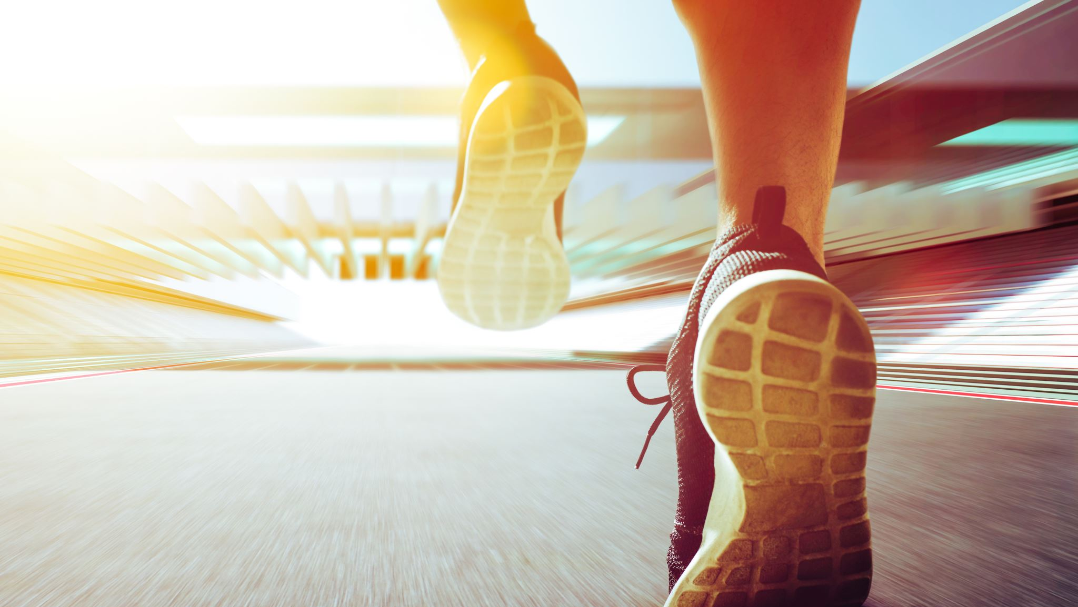
Physical Activity
Discovering Enjoyment and Consistency With Movement
By Katie Godin, RD, LDN

Slide 3
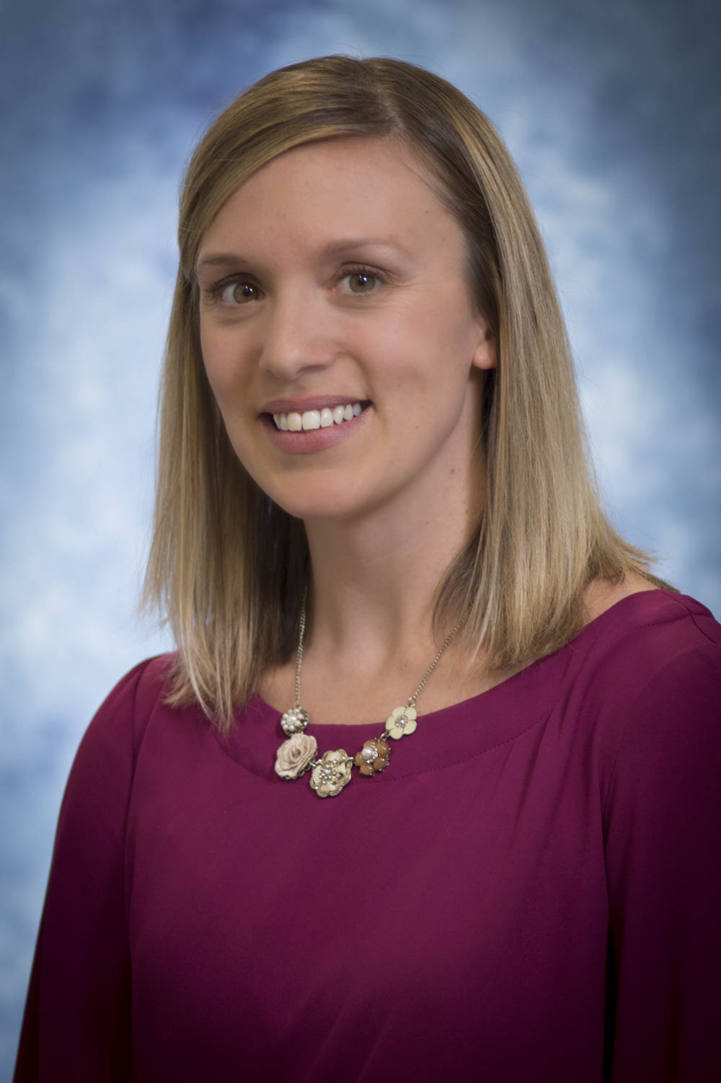

Katie Godin, RD, LDN
Lifestyle Medical Centers offers Nutrition Counseling to assist with educating you on how to make positive lifestyle changes alongside continual support and encouragement.
Services offered:
Weight Management
Women’s Health
Sports Nutrition
Chronic Disease Counseling
Bariatric Support
Smoking Cessation
Sleep Assessment and Stress Management
https://lifestylemedicalcenters.com/
Notes:
Lifestyle Medical Centers is a Raleigh-based healthcare provider offering an integrated weight loss program. LMC offers medical experts (Endocrinologist, Nurse Practitioner, Physician’s Assistant, Registered Dietitians, Medical Assistants) , customized plans and digital monitoring tools along with nutritional guidance, lifestyle modification programs, affordable medication prescriptions and management options to meet patient needs.

Slide 4
Why Physical Activity Matters
Physical Health
Bone / Muscle strength
Heart / Lung health
Maintain healthy weight
Mental Health
Decrease stress / anxiety
Mood boost / self confidence
Enhances focus / concentration
Better Daily Living
Increased energy
Improved sleep quality
Supports overall quality of life
Builds Healthy Habits
Promotes an active lifestyle
Reduced risk of chronic disease
Contributes to long term health / overall independence as we age

Slide 5
Recommendations for Children (5-17 years of age)
Aerobic Activity recommendations:
150-300 minutes of moderate-intensity aerobic activity per week or 75-150 minutes of vigorous-intensity activity.
Activities : Team sports, running / playing tag , jump rope, dancing, swimming, biking.
Strength / Muscle building Activity
At least 3 days of week of these activities:
Muscle Strengthening: Climbing (play equipment), gymnastics, monkey bars, push ups / sit ups.
Bone Strengthening: Jumping, skipping, basketball, running

Slide 6
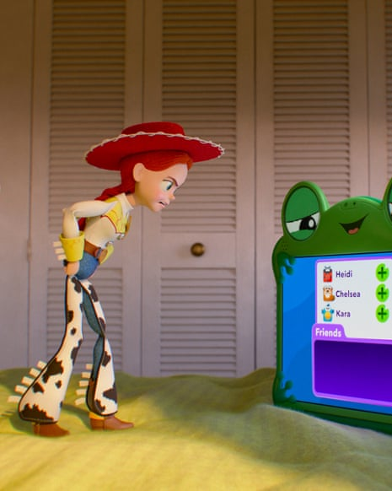
Did You Know……
Based on a national survey, 70% of mothers played outdoors daily as children, compared with only 31% of their children today.
Average child (8-18) is on a screen / device for 4 hours per day , spending 5 hours or less of free outdoor time per week.
Only 1 in 5 kids meets the standard 60 min / day of activity.

Slide 7
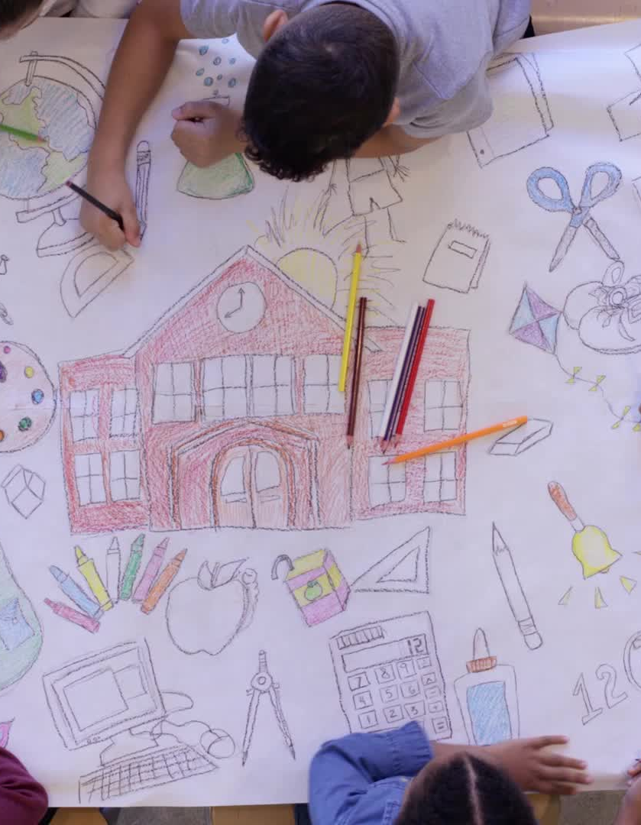
How to Make Outdoor Time FUN for Children! Get CREATIVE!
Scavenger hunts , outdoor hikes, and other interactive play ideas!
Bring indoor activities outside (reading, drawing).
Get a group of kids together for a fun active day (sports related or other outside games).
Parents get involved! Family time = outdoor time. The best way to get kids excited is for parents to lead by example!

Slide 8
General Recommendations : Adults (18+)
Aerobic : 150-300 minutes of moderate-intensity aerobic exercise or 75-150 minutes of vigorous activity.
Moderate Intensity (can talk but not sing during exercise) : Brisk walking, water aerobics, doubles tennis / pickleball, riding a bike on flat surface.
Vigorous Intensity (can not carry a conversation during exercise) : Running, swimming laps, jump rope, hiking uphill, heavy yard work (digging)
Bone / Muscle Strengthening: At least 2 days a week of full body focused strength exercises
Muscle Strengthening : Free weights / machines, resistance bands, bodyweight exercises (push ups, squats, lunges, planks), heavy gardening, carrying heavy groceries, pilates, climbing stairs).
Bone Strengthening : Brisk walking, jogging/running, hiking, dancing, resistance training, climbing stairs, jump rope.
Flexibility / Balance (very important 65+) : Tai Chi, Yoga are great to incorporate.

Slide 9

Find Your WHY! Try the 5 Why Method
#1 : Start with “Why do you want to exercise”? For ex – It could be to have more energy, to lose weight, or to be healthier.
#2 : Ask yourself “why” to that answer. If your answer is to lose weight. Maybe your answer to “why” is to have more confidence”.
#3-5 : Continue to ask why to each answer and you develop some core values associated with this initial idea of exercise and how it can better your life, for you!
Finding relevance is KEY to staying MOTIVATED which becomes KEY for CONSISTENCY

Slide 10
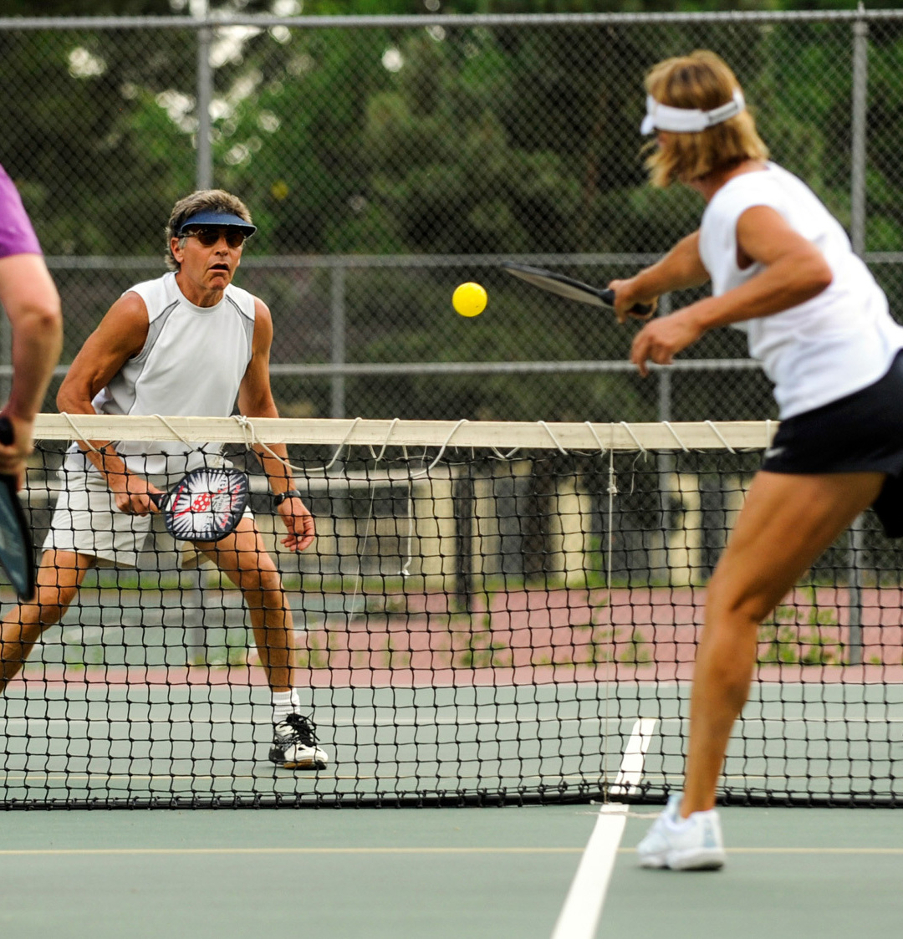
How To Find What You Enjoy : Discover Your Movement Style!
Explore different styles
  Class setting, Gym , Personal trainer, At home workouts
What are you interested in?
  Nature, Indoors vs Outdoors, Being with friends vs. alone
Did you play sports at some point?
  Ex. Tennis in high school / college? Give pickleball a try! Or doubles tennis with a friend!
REMEMBER!
Make sure to set realistic goals! Overcomplicating your goal is a quick way to losing interest!
Focus on fun, not perfection!

Slide 11
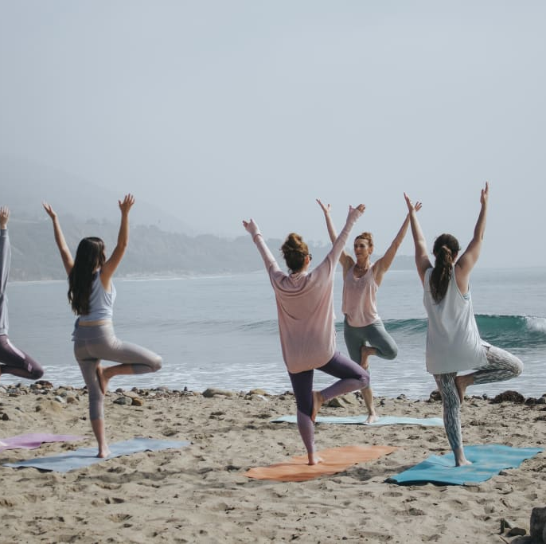
Why Does Enjoyment of Activity Matter?
Consistency : People who enjoy activity will typically stick with it longer than those who do not.
Motivation is stronger , which is why you stay consistent.
More likely to build a lifelong habit.

Slide 12
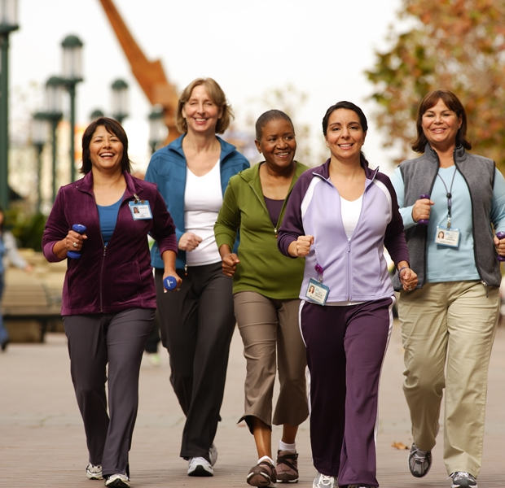
Getting Creative with Movement ☺
Living room dance parties! Break up TV shows with movement or just have a plan to do 10-15 min of movement after dinner!
Exercise “snacks” at work (2-3x/day try 1-2 min of body weight exercises like squats, lunges, desk push ups, calf raises…)
Get active for those social catch ups or have walking meetings when able.
Save podcasts / audio books for exercise.
Try something new like a group fitness class! Bring a friend!

Slide 13
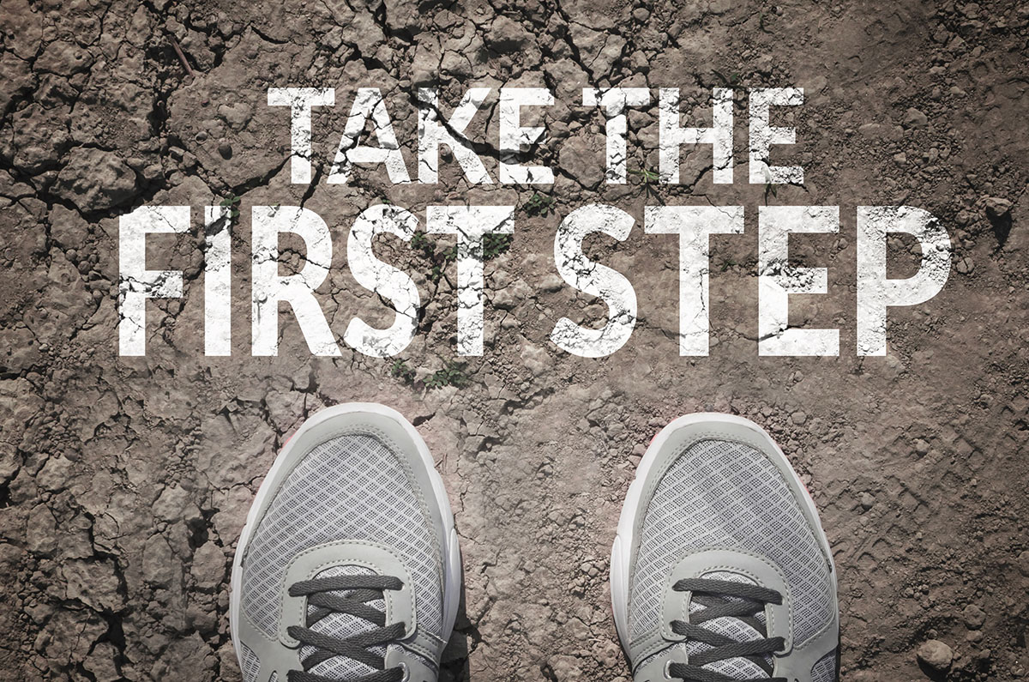
Overcoming Barriers
Lack of Time?
  Set short activity breaks. Break it up into 3 sections (10 min of walking, 3x / day)
Low Motivation?
  Find accountability! Schedule activity with a friend when able , try a group class, or text a family member or friend your goals for the week to stay accountable.
Boredom?
  Think outside of the box! Fitness can look a lot of ways. Go back to what your core interests are and start there!
Weather?
  Always have indoor alternatives. It’s helpful to embrace moving your body in lots of ways vs. just relying on 1 activity to count towards your activity goals.

Slide 14
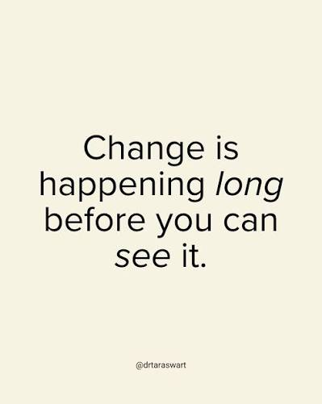
Tips for Consistency
First and most importantly, find something you enjoy!
Start VERY small. Overcommitting = burnout.
Schedule it! Just like a meeting.
Plan ahead. Alarm set (if early morning), outfit/shoes picked out and visible.
Pair with entertainment (favorite podcast, audio book, playlist, or TV show).
Track progress (non scale victories!) : Sleeping better? Lower stress? Energy improved? These are huge motivators for staying consistent!

Slide 15

Key Takeaways
Physical Activity enhances not only your physical health but your mental health and overall quality of life.
Find relevance and uncover the WHY when it comes to caring about your physical health.
Remember how important and achievable it is to find enjoyment with your physical activity.
Get creative to find enjoyment. Creativity can lead to enjoyment, and enjoyment can lead to consistency!
Barriers are temporary and can always be tackled!

Slide 16
References
https://www.mdpi.com/1660-4601/9/9/3134?utm_source
https://www.drsharongam.com/articles/five-questions-to-find-your-motivation-to-exercise (The 5 Why’s)

Slide 17
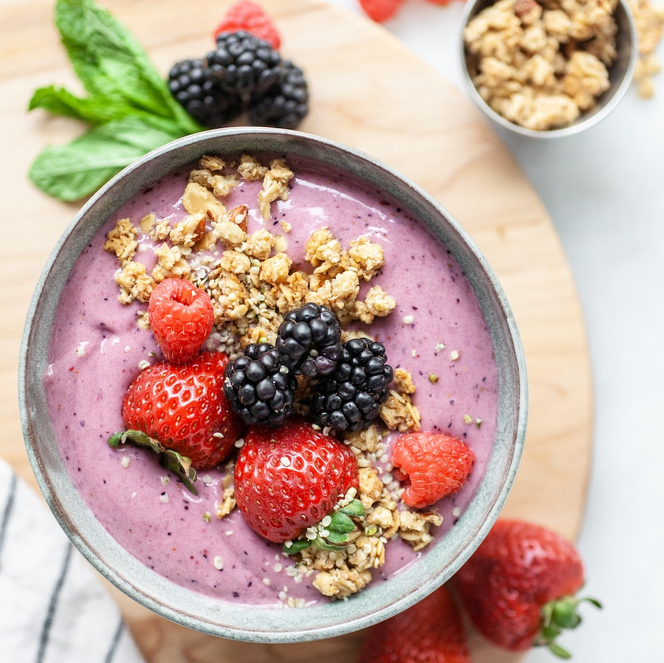
Let’s Cook!
Smoothie Bowl!
Recipe: https://nutritioninthekitch.com/make-a-perfect-berry-smoothie-bowl-in-5-simple-steps/
Nutrition Facts:
360 calories
27g Protein
14g Fat
47g Carbohydrate
8g Fiber
NOTE: To cut down carbs you could: Use a Plain Protein Powder and omit the banana and swap in avocado for more fat.

