Slide 1
NCFlex
Employee Session
Dental Plan Options
July 2026
Notes:
Good afternoon, thank you so much for joining us today for the NCFlex employee session to discuss our dental plan options. This is Stephanie from NCFlex. Other members of our NCFlex team is on the call the help answer any questions as well as Jackie who is a MetLife consultant. We also have Tate and Liz from SignNexus who will be providing ASL sign language services for those who need to access those services. There is a Q&A box where you can type any questions you may have throughout the presentation. Slides and presentation will be added soon to NCFlex webinar page. I know several of you may be on your lunch break so we will go ahead and get started with the presentation.

Slide 2
AGENDA
1
Benefits of Choosing NC Flex Dental
Dental Plan Overview and Comparisons
2
3
Dental Plan Rates
4
In Network Savings
5
6
7
8
Using your HCFSA for out-of-pocket expenses
Finding a Dental Provider
Dental Travel Assistance
MetLife Mobile App
Notes:
Today we want to discuss the benefits of choosing an NCFlex dental plan, we will look at the three plans offered with a brief comparison of their coverage levels, rates for those dental plans, advantages of using an in network provider, using your HCFSA for those additional out of pocket expenses, how to find an in-network dental provider, the dental travel assistance program, as well as the MetLife mobile app.

Slide 3
Benefits of Choosing NCFlex Dental
Pre-Tax payroll deductions - Save 25% to 40% in taxes
Three plans to choose from so you can find a plan that fits your needs
Plan transfers between state agencies, universities, participating community colleges and participating charter schools
Negotiated fees for in network providers are typically (30% to 45%) less than the average charges in the same area
Choose from a large network of carefully selected participating dentists. Plus access to international dentists in more than 200 countries through the International Dental Travel Assistance Program
Flexibility to go to any dentist – in or out of network
Notes:
First let’s take a look at the benefits of choosing to enroll in a NCFlex Dental plan
All NCFlex plans are pre-tax plans so you save 25% to 40% in taxes when enrolled in one of these plans
You have three plans to choose so you can choose which plan fits your needs
These plans will transfer between state agencies, universities, participating community colleges and charter schools
There is a large network of carefully selected providers who are considered in-network. You also have access to dental providers in more than 200 countries with the international dental travel assistance program which is included in the dental plan.
If you are visiting an in-network provider your claim will be processed using negotiated fees which will result in a cost savings to you. Those negotiated fees are typically 30 to 45% less than out of network provider in the same area.
Although there are benefits for using an in-network provider, you can still use an out of network provider for dental services

Slide 4
Dental Plan Overview
Administered by MetLife
Low, Classic, and High plan
Member Portal and Mobile App
ID Cards with unique ID
Large Preferred Dental Provider Network
You can see any licensed dentist for care, but save money when you visit a MetLife Preferred Dental Provider (PDP)
Log into www.metlife.com/mybenefits to print cards, view claim status, or find a participating dentist (NCFlex as organization name)
  Also, single sign-on option through eBenefits and Empyrean
  Access the MetLife Mobile App for on-the-go access
  Watch the MyBenefits video to learn more on how to use the tools
Notes:
Here is an overview of our NCFlex dental plan
This plan is administered by MetLife
MetLife has a large network of providers but as mentioned before you can see any licensed dentist for care
There are three plan options to chose from – the low plan, the classic plan, and the high plan
You have access to a member portal and mobile app where you can access your ID cards, view claim status, or find a participating dentist.
You can login to www.metlife.com/mybenefits to view this information. For information on how to use the member portal, you can view the MyBenefits video link which we will put in the chat box for you.
You can access the member portal through a single sign-on through your benefit enrollment platform of eBenefits or Empyeran
You can also access the benefits information through the MetLife mobile app so the information is at your fingertips

Slide 5
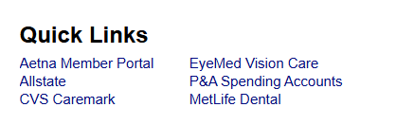
Logging in from eBenefits or Empyrean with Quick Links
As mentioned before, you can access the MetLife Member portal through your enrollment platform whether it be eBenefits or Empyrean. If you login through eBenefits, you will find the quick links tab at the top right side of the screen and then click on the MetLIfe Dental link. For Empyrean users, you will find the additional items to explore tab and find the MetLife Dental tab to access the portal.
Once you are logged into your benefits portal (eBenefits for Non-University and Empyrean for University), find Single Sign-On links in the menu.
Notes:
As mentioned before, you can access the MetLife Member portal through your enrollment platform whether it be eBenefits or Empyrean. If you login through eBenefits, you will find the quick links tab at the top right side of the screen and then click on the MetLIfe Dental link. For Empyrean users, you will find the additional items to explore tab and find the MetLife Dental tab to access the portal.

Slide 6
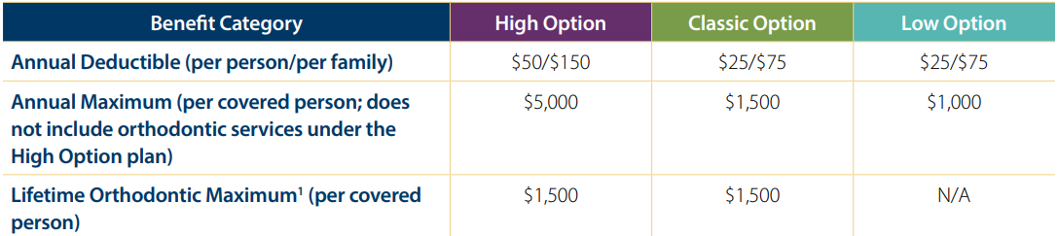
Dental Plan – Plan Comparisons
Notes:
Lets take a look at the difference in the three plans. As we mentioned earlier there is the Low plan which is under the teal colored tab, a classic option which is under the green tab, and a high plan option which is under the purple tab. The annual deductible is relatively small for all plans at $25 per person for the low and classic plans and $50 for the high plans. As you are considering which plan to enroll in for the upcoming year, you will want to pay close attention to the Annual Maximum as you can see here on the screen there is a pretty significant difference here between the plans. The annual maximum is the amount MetLife will pay toward dental services for the calendar year. The low option has a $1000 annual max where the high option has a large annual max of $5000. The classic plan falls in the middle with a $1500 annual max for the calendar year.

Slide 7
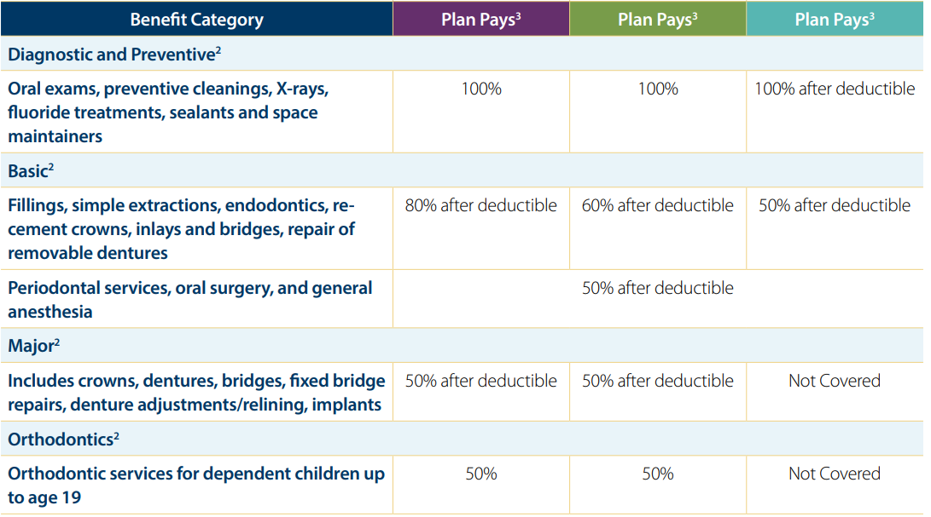
Dental Plan – Plan Comparisons cont...
Notes:
On this next screen we are going to look at the coverage for basic services such as fillings, simple extractions, recementing a crown and things of that nature. You will see on the low plan these services are covered at 50%. The classic covers these services at 60% and the high plan covers these services at 80%. This is great information to know if you are planning to have services in the near future or if you are planning dental services for the 2027 plan year.

Slide 8
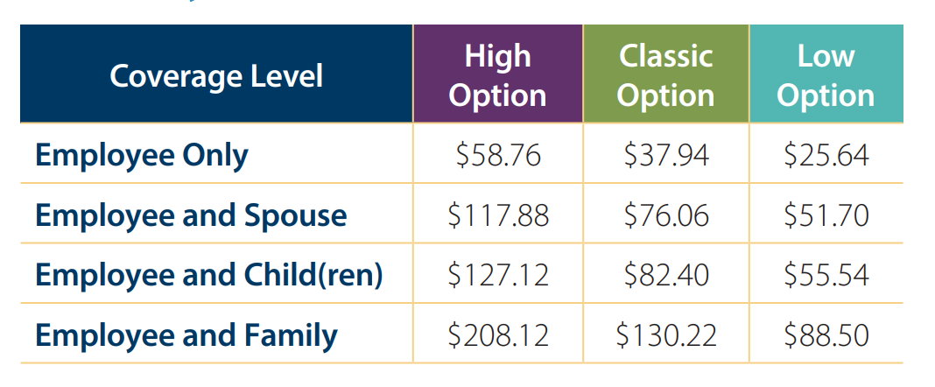
Dental Plan - Rates
Notes:
After you have an idea of what type of coverage would be helpful for your current dental needs, you can view the dental plan rates for a better idea of what option will work best for you. You can see here that in additional to three plan options to chose from, you have four levels of coverage to chose from as well. Employee only, Employee and Spouse, Employee and Child or children and this is the same rate if you have one child or if you have multiple children and finally the employee and family coverage level which will cover you, your spouse, and all of your children for the flat rate listed on the screen.

Slide 9
Examples of 25% Pre-Tax Savings
As a reminder, premiums come out of your paycheck Pre-Tax, saving you money.
Dental Coverage
Classic EE Only
High EE + Family
Low EE + Child
Monthly Premium | Monthly Pre-Tax Cost | Monthly Tax Savings | Annual Tax Savings
$37.94 | $28.46 | $9.48 | $113.76
$208.12 | $156.09 | $52.03 | $624.36
$55.54 | $41.66 | $13.88 | $166.56
Notes:
As we discussed earlier, a benefit of enrolling in a dental plan is a tax savings. Since the premium is a pre-tax deduction, you will have a tax savings on your paycheck. How a pretax deduction works is your gross salary is calculated, all pretax deductions are subtracted from that gross salary, and the remaining salary is taxed. Here is a chart that gives you an example of how much more you would pay in taxes if you did not have the pretax deduction. We will use the pre-tax savings of 25% for this scenario. For the first example, this employee has employee only classic dental coverage. The monthly premium is $37.94 which is subtracted from the gross salary so the salary is taxed $9.48 less than if the deduction was not taken so the true cost of the benefit was only $28.46. That will give a tax savings of $113.76 for the year. Of course, the higher the premium the more tax savings you receive such as in the next line which shows the Employee and family high plan with a tax savings of $624.36.

Slide 10
Dental Cost Estimator
Log into your MetLife Dental member portal
Choose “Benefits & Coverage” and then “View Procedures & Coverages“
Choose the procedure from the View Procedures and Costs list (having a procedure code can help)
For Out of Network Providers have your dentist submit a Pre-Treatment estimate to MetLife for a cost estimate
Notes:
Next we are going to look at the dental cost estimator. You will need to login to your Metlife dental portal to view this cost estimator. Once logged in, you will chose the benefits and coverage tab and then chose the section that reads view procedures and coverage. Chose a procedure from the list to see how much you should expect to pay for that procedure. It would be helpful to have the procedure code from the dentist to get a true estimate from this estimator. The estimator is for in-network providers only. If you would like a cost estimate for an out of network provider, have your dentist submit a pre-treatment estimate to MetLife for an accurate cost estimate.

Slide 11
Dental – Network Savings Example
In-Network Savings Example (High Plan)
This hypothetical example of needing a crown, shows how receiving services from a participating dentist can save you money.
 | Katie’s dentist is In-Network | Jan’s dentist is Out-of-Network
Dentist’s usual Charge | $1462.00 | $1462.00
Negotiated fee | $680 | N/A
R&C fee | N/A | $1451
The Plan Pays (50%) | $340 | $725.50
 | Katie pays $340.00 | Jan Pays $736.50
Notes:
We have mentioned several times the phrase in-network or out of network providers and this slide will give you an idea of why that is important. In this scenario the employee is enrolled in the High dental plan. Both of these employees are needing a crown. Katie visited an in-network profider and Jan visited an out of network provider. Lets explore how each claim was processed and what the out of pocket expense was for each employee.
Katie used an in -network dentist who had a negotiated rate with Metlife. A negotiated rate means that the dentist will not charge the employee for any amount over the negotiated fee and MetLife will be their percentage covered based on the negotiated fee. In this scenario, the negotiated fee was $680 and MetLife paid 50% of that at $340 leaving Katie with a balance of $340
Jan used an out of network dentist where there is no negotiated fee and the employee will be responsible for the full amount of the procedure. Metlife processes the claim using the reasonable and customary fee and will pay the percentage covered based on that reasonable and customary fee. In this scenario the R&C was $1451 so MetLife paid 50% which was $725.50 leaving Jan with a balance of $736.50. I am sure you can see from this scenario the benefit of visiting an in network provider

Slide 12
HCFSA and Out-of-Pocket Expenses
NCFlex offers a Health Care Flexible Spending Account (HCFSA) which can help with out-of-pocket dental expenses.
The 2026 limit is $3,300
This money comes out of your check pre-tax and is loaded onto a card
Use your Explanation of Benefits (EOB) from MetLife's My Benefits portal to file a claim or substantiate a claim if needed
If you are planning major work, get a pre-estimate from MetLife first to help plan for your HCFSA in 2027
Notes:
In some cases we know there is going to be an out of pocket expense when visiting any provider but sometimes this may catch us off guard and that is why having a HCFSA is important. When enrolled in a HCFSA you will receive a convenience card with funds already loaded onto the card to help pay for the expected or unexpected expenses. You can simply swipe the card at the time of service or you can always file a claim to receive those funds if you are like me and sometimes forget to use the HCFSA card. If you are planning major dental work for 2027, get a preestimate for those services so you can select a HCFDS amount that is right for you. This benefit is a pre-tax benefit as well so there is the savings for this benefit like we discussed a few slides earlier.

Slide 13
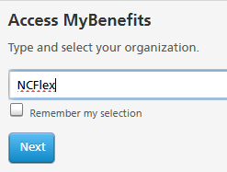

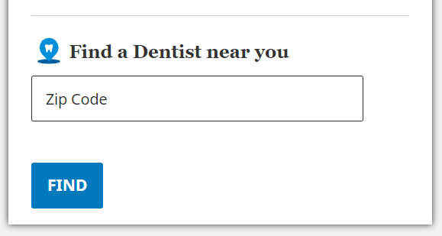
Find a Dental Provider
Step 1: Go to metlife.com/mybenefits and enter "NCFlex" as the organization name
Step 3: Review a list of in-network providers
and specially designated SpotLite providers.
Focus on Prevention: These dentists are recognized for catching issues early and emphasizing preventive care, helping you avoid more invasive and expensive procedures down the road.
Lower Out-of-Pocket Costs: Patients who visit SpotLite dentists see an average of 17% in cost savings compared to traditional in-network options.
Verified Quality: These providers are selected using a rigorous, proprietary data evaluation process that adheres to industry-recognized quality standards.
Step 2: Either Login or Register and choose "Find a Dentist" under your account, or if you do not want to login, scroll down to "Find a Dentist near you" and enter your zip code

Slide 14
MetLife Travel Assistance
MetLife provides International Dental Travel Assistance services tied to the dental benefits you already receive.
Access to providers in more than 200 countries
Providers selected based upon strict credentialing criteria
MetLife does not require pre-authorization for non-emergency services occurring outside of the U.S., but they do recommend it.
Reimbursement - Coverage will be considered under your out-of-network benefits. Retain all receipts to submit a claim.
MetLife does not maintain an online provider file for dentists located outside of the U.S.
If you are in the U.S. and planning an international trip, call 1-888-558-2704 for help in locating a participating dentist. If you are traveling within the U.S., please visit www.metlife.com/dental to find a participating dentist.
Flyer available in the Dental section of ncflex.org.

Slide 15
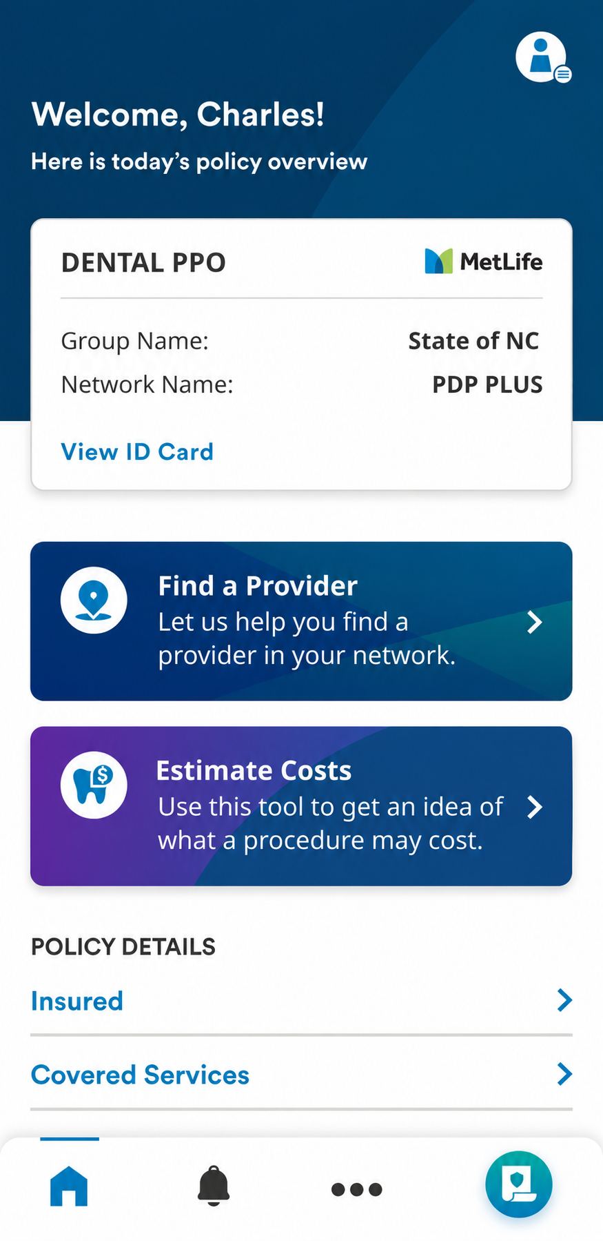
MetLife Mobile App
Find a dental provider
Get estimates for most procedures
Enhanced to display personalized, plan specific costs and additional information such as percent covered, applicable deductible, Plan Maximum and Frequency Limits
View your plan summary including deductibles, plan maximums, covered services, and frequency limits
View your claims
Access and save ID card to photo library or mobile app
Search “MetLife” at iTunes App Store or Google Play to download app.

Slide 16
NCFlex Resources
NCFlex Website – www.ncflex.org
Review details on each plan – with certificates, claim forms, FAQs, videos, and more
NCFlex Email – ncflex@nc.gov
Correspond with a NCFLEX Benefits Consultant
1-855-676-9441
MetLife
Enrollment Guide
Metlife.com/mybenefits
MyBenefits video

Slide 17
Questions?
Notes:
Next month there will be an NCFlex employee session to discuss
Thank you for joining us today. Have a wonderful rest of your day.

