Slide 1
Sensible Savings
Session
Summer 2026

Slide 2
Today’s General Agenda
1
NCFlex Pre-tax Benefits
NC State Employees Credit Union
2
3
BREAK
4
NC Total Retirement Plans
- NC State Retirement Systems
- State NC 401(k)/457-Empower

Slide 3
Place Questions in the Chat

Slide 4

NCFlex Benefits Program
Financial Wellness
Stretching your Benefit Dollars
Wellness Components

Slide 5


NCFlex Enrollment Guide has all the details
  Health Care FSA
  Dependent Day Care FSA
  Accident
  Cancer and Specified Disease
  Critical Illness
  Dental
  Vision
  Group Term Life
  Voluntary Accidental Death & Dismemberment
  Core Accidental Death & Dismemberment
  Disability Income Plan
  TRICARE Military Supplement

Slide 6
NCFlex Benefits
Offers exceptional group rates through the buying power of the state as a large entity
Payroll deducted on a pre-tax basis
Saves you 25-40% in taxes on premiums depending on your tax bracket
Website
  NCFlex.org
  Enrollment Guides and Plan Details
  Monthly Benefit Webinars
  Monthly Newsletters
Fall Annual Enrollment (Oct 12 – Oct 30, 2026)

Slide 7

Health Care Flexible Spending Account
  Pre-tax Savings
  Annual Max
    2026-$3,300/2027-$3,400
    Incur expenses Jan 1 – Dec 31
  Covers out of pocket eligible expenses
    Any Medical Plan
    Any or No Dental Plan
    Any or No Vision Plan
  Over the counter
  FSA Sample Eligible Expense List
    https://oshr.nc.gov/ncflex-sample-list-fsa-eligible-expensespdf/open
  Expenses for participant and eligible dependents
  FSA Rollover
    On December 31, $25 up to $660
Pre-Tax reduces your taxable income!

Slide 8
Dependent Day Care FSA
$7,500 pre-tax savings account maximum for most employees (per household)
Reimbursement is limited to your available account balance
Incur expenses 1/1/2026 through 3/15/2027
Submit eligible expenses through 3/31/2027
If you are not sure yet of future day care expenses, enroll later with the life event “Day Care Change” within 30 days of an event such as starting Day Care

Slide 9
FSA Convenience Card
Convenience card provided at no charge
No additional charge for dependents or replacement cards
Outside of card, claims can be filed:
  Online P&A Group FSA portal (ncflex.padmin.com)
  Paper Form-Mail or Fax (claim form)
  Mobile app – “P&A Group – MyBenefits” (P&A Group mobile app)
Re-enrollment required each year to continue contributions, even if same dollar amount

Slide 10

Wellness Benefit Reminders
Included on Accident, Critical Illness, and Cancer plans
  Accident and Critical Illness Wellness Benefits are filed through Voya
  Cancer Wellness Benefit is filed through The Standard (formally Allstate)
Each plan allows 1 Wellness Benefit payout per year (no matter the number of screenings) per covered person
If an employee has multiple plans (i.e. Accident and Cancer) they can file for a Wellness Benefit on each plan
Flyers can be found at ncflex.org on how to file your wellness claims:
  Accident and Critical Illness - https://oshr.nc.gov/ncflex-critical-illness-and-accident-wellness-flyer/open
  Cancer - https://oshr.nc.gov/documents/files/allstate-wellness-benefit-flyer-2019/open

Slide 11
Early Cancer detection and treatment advances have reduced cancer mortality rate in the U.S. by 34% in the last 30 years
  American Cancer Society-2025

Slide 12
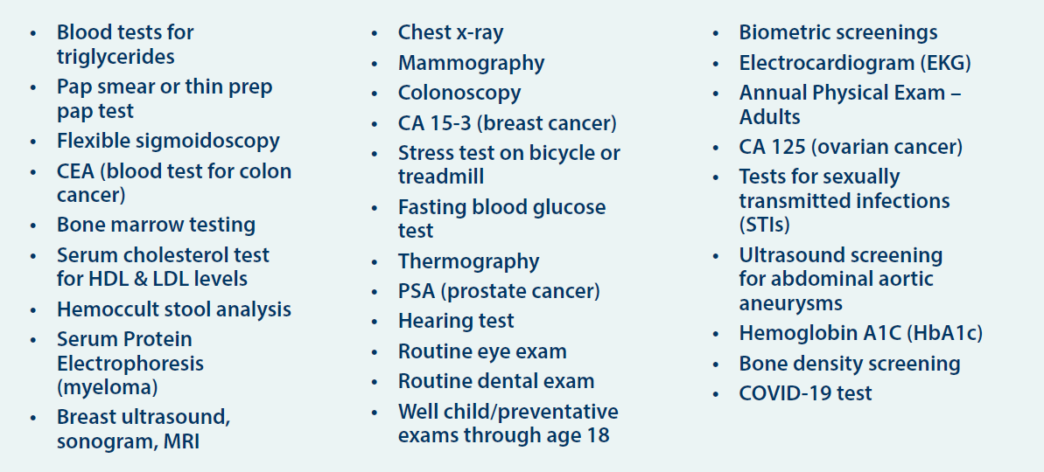
Annual Wellness Benefit Preventive Screenings
Accident 1 per year
  $50 for employee
  $50 for covered spouse
  $25 for covered Child(ren)
Critical Illness 1 per year
  $50 for employee
  $50 for covered spouse
  $25 for covered Child(ren)

Slide 13
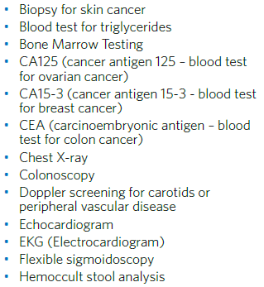
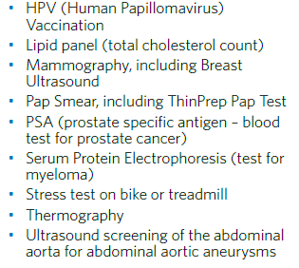
Annual Wellness Benefit Preventive Screenings
Cancer 1 per year:
  Low Option-$25
  High Option-$100
  Premium Option-$100

Slide 14

Sickness Hospital Confinement Benefit
Included Accident Enhanced Option
Pays a daily benefit for each day you or your covered dependent is confined to a hospital due to a covered sickness, up to 30 days.
Benefit for covered employee and spouse: $200 per day
Benefit for covered child(ren): $150 per day

Slide 15
COVID-19 Benefits
Included Critical Illness Plan
Infectious Disease Benefit
  $100 once per calendar year per covered person with a confirmed COVID-19 diagnosis from a medical professional/facility
Hospital Confinement Benefit
  $2,000 once per calendar year per covered person if confined to a hospital due to COVID-19

Slide 16
Group Term Life Insurance*
Accelerated Death Benefit
  Six-month terminal diagnosis - 50% of life insurance amount, remaining 50% of life insurance amount is paid to beneficiary upon death
Continuous Confinement Benefit
  Upon diagnosis of a terminal illness or condition requiring continuous confinement rest of life - 50% of life insurance amount, remaining 50% of life insurance amount is paid to beneficiary upon death
Access to funeral planning and online Will Prep,
  Empathy - Bereavement Support, including Funeral Support & Estate Planning
*non-university employees only

Slide 17

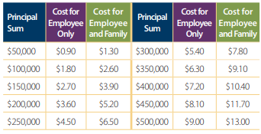
Accidental Death and Dismemberment*
Core AD&D $10,000 employee coverage
  free to all eligible state employees
Voluntary EE and Family coverage with pre-tax premium:
*non-university
employees only

Slide 18

Voya Travel Assistance*
Travel Assistance Included
  Accident Plan
  Core AD&D Plan*
  Voluntary AD&D Plan*
More 100 Miles From Home
Emergency Medical Transport
  Vehicle Return Service
  Visit of Family Member or Friend
  Repatriation of Remains
Website, Voya Travel Assistance
  *non-university employees only

Slide 19

Vision: Three Plan Options
(1) Core Wellness: $20 eye exam co-pay, discount on materials
  Free to eligible state employees
  Employees must enroll to receive employee only benefit
(2) Basic Plan and (3) Enhanced Plan
include routine eye exam and materials coverage for employees and their dependents
  Frame allowance:
    Basic - $125 once every 24 months
    Enhanced - $200 once every year
  Contact lenses allowance:
    Basic - $120 per year
    Enhanced - $175 per year
Hearing Health Care and LASIK benefits included on all three coverage levels
Know Before You Go Tool,
https://oshr.nc.gov/eyemed-know-you-go/open

Slide 20
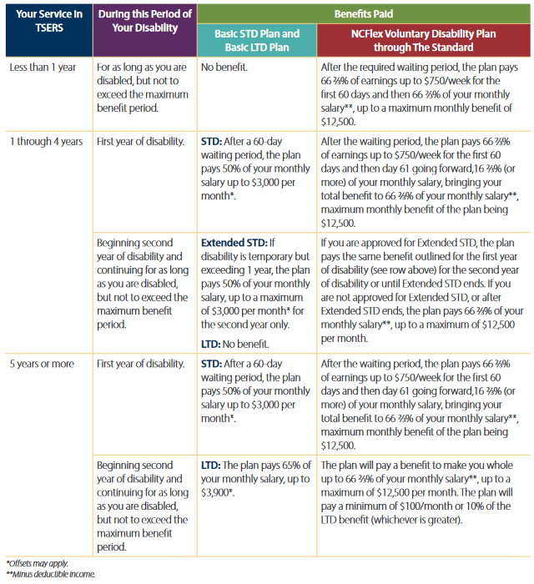
NCFlex Voluntary Disability*
Information Chart in NCFlex Benefits Enrollment Guide
Short Term Period
Long Term Period
  Until Normal Social Security Retirement Age
*non-university employees only

Slide 21
Additional Features for
NCFlex Voluntary Short-Term Disability
24 Hour Coverage
  Covers disabilities that occur on and off the job.
Health Advocate Select
  While on an approved STD claim, employees will have access to a dedicated Personal Health Advocate that can assist them with a wide range of services such as coordinating health care with specialists and managing billing questions.
Reasonable Accommodation Expense Benefit
  Designed to help cover the cost of accommodations that allow the employee to stay at work or return to work following a disabling condition.

Slide 22
Additional Features for
NCFlex Voluntary Long-Term Disability
24 Hour Coverage
  Covers disabilities that occur on and off the job.
Return to Work Incentive
  With this incentive, Standard only deducts a portion of earnings for work performed while on disability.
Reasonable Accommodation Expense Benefit
  Designed to help cover the cost of accommodations that allow the employee to stay at work or return to work following a disabling condition.
Survivor Benefit
  If the employee dies while LTD benefits are payable, a Survivor Benefit may be payable. The Survivor Benefit is 3 times her/his LTD Benefit.

Slide 23
Waiver of Premium
NCFlex Cancer, Critical Illness, Term Life*, Voluntary AD&D*, and Voluntary Disability* plans have waiver of premium options when an employee is disabled and satisfies certain conditions
  Contact the vendor for more information and applicable forms
  The NCFlex Voluntary Disability plan with The Standard does not require a Waiver Form. If the employee is approved for LTD benefits through NCFlex Voluntary Disability with The Standard, the payroll unit should no longer deduct for this benefit.
Most plans have a 1-year limit to apply for waiver of premiums
*non-university employees only

Slide 24
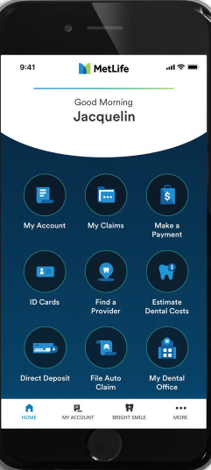
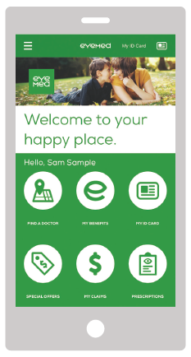
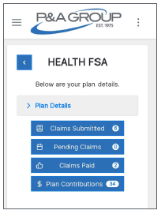
Smart Phone Apps
Dental-MetLife
Vision-EyeMed
FSA-P&A Group

Slide 25

Check website and NCFlex Enrollment Guide for full details.
NCFlex.org

Slide 26
5 Minute Break
As We Bring on
NCSECU

